Slide 1
Experimental Design and Analysis
George Savva
Quadram Institute Bioscience

Slide 2
Welcome
Introductions
Choose one!
What are you working on?
What kind of experiments do you do?
What brings you to this course?
How is sample size planning usually done in your area?

Slide 3
Outline for the course
Morning
Principles of experimental design
Bias and randomisation
Afternoon
Hypothesis testing revision
Replication and sample size
Application to the microbiome
Tuesday / Wednesday
More in depth coverage on core statistical concepts with the professionals!

Slide 4
Introducing myself
Statistician at Quadram Institute Bioscience
Microbiology
Animal work
Human clinical trials
Epidemiology
Previously! Epidemiologist with routine data and cohort studies (ageing/cognition)

Slide 5
Take home message - Read!
Methods textbooks
Including experimental design and
Statistical analysis
Zeitgeist
General journals / Science social media / Blogs / Science news / policy
Eg replication crisis, meta-science, new computational tools etc
Tutorial papers
Method and field specific, very accessible
Do bioinformaticians need ‘basic’ statistics??
Bioinformatics / data science is a different skill set to statistics
Methods are highly computational, can deal with complex models of data from different sources
Much of bioinformatics is repeated application of basic statistics (often forgotten in the complexity)
The basic experimental design principles are exactly the same!

Slide 6
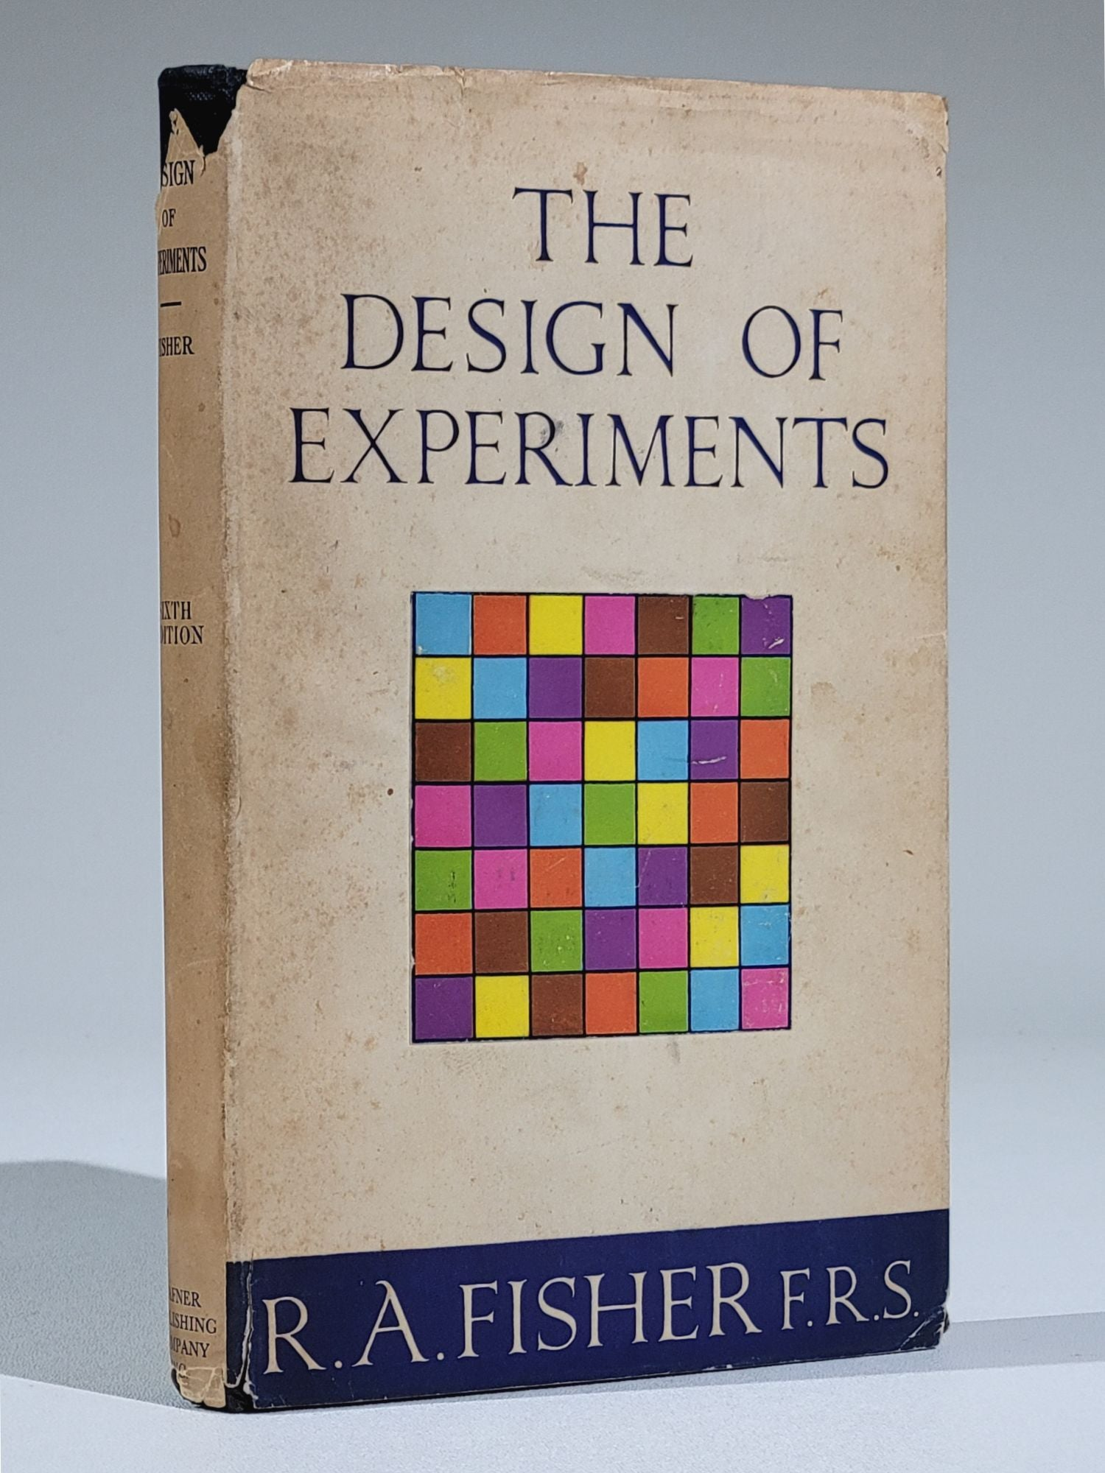
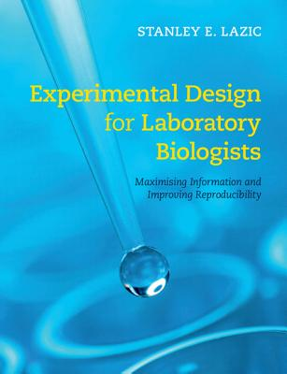
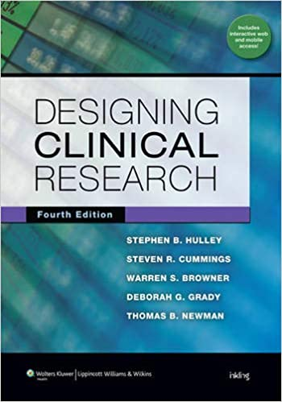
Experimental design texts
1949 (5th ed). But still very relevant and interesting to read.
A word on Fisher and Galton..
Very practical and accessible, particularly useful for animal studies but also for bench scientists
The basics of doing research with actual people in a clinical context

Slide 7
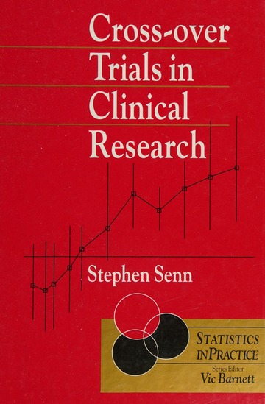


Specific methods texts
Texts for specific designs, and those I’ve had recommended by PIs for different disciplines.

Slide 8
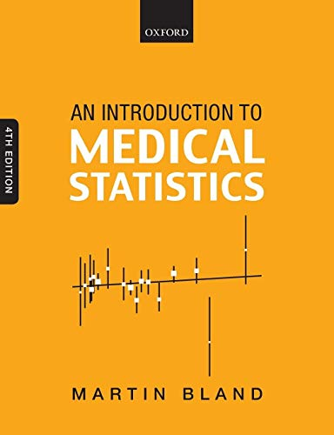
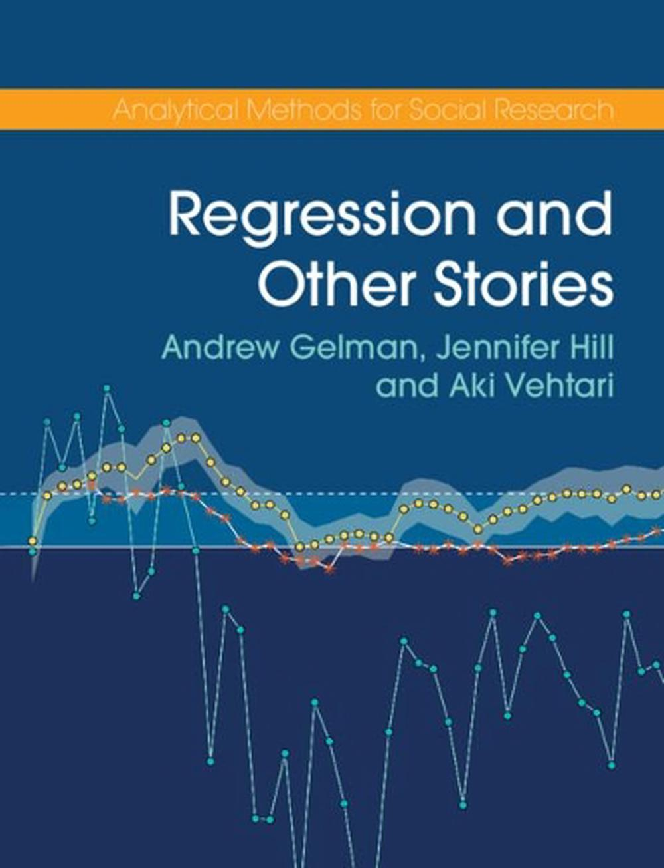

Analysis texts

Slide 9
How good are we at science?
It’s worth understanding the state of the art.
Is our current practice OK?
Are our findings true?
Do our methods work?
How would we know if the results we produce are ‘correct’?

Slide 10

Direct evidence: Reproducibility project cancer biology
Aim: Test the results of preclinical studies in cancer research.
Key results taken from high quality journals
Experiments repeated as closely as possible with proper designs
Sample sizes calculated to achieve 80% power
158 published effects re-examined.
Questions for you
If all of the published results were correct, how many results should have been replicated?
What does it mean for a study to fail to replicate?
Guess what proportion of 158 results in basic oncology were successfully replicated?
If you took a random high-profile published result in your area and replicated it, what do you think the chance is that you’d get the same result?
https://www.cos.io/rpcb

Slide 11
Results
Same direction and significant…
Perfect – 80%
Completely by chance – 2.5%
How many of the studies replicated?
Of ‘significant positive findings’ (97 tested)
42 / 97 = 43% positive effects were reproduced
Effect sizes were ~75% lower in the replications
Questions for you:
What does this mean?
Why do you think basic science studies fail to replicate?
Is it a problem for the field?
What is the harm?
How should you respond to this?
https://www.cos.io/rpcb

Slide 12
Reasons for replication failure?
Most published effects are real but vary in size across contexts. Only large effects are published, maybe because of fudging, maybe by luck
So the published result is probably correct, but overstated, and direct replication has a high chance of failure.
At least three competing ideas: Low replication rate reflects:
A lot of bad science
True positive hypothesis being rare
Contextual variation in the size of ‘true’ effects
Truly good ideas are very rare and hard to find.
So the literature is dominated by ‘chance’ findings.
Poor design and analysis means mistakes very common
Mistakes / fudging / fraud mean that scientists publish results that aren’t real.
Maybe some truth in all three?

Slide 13
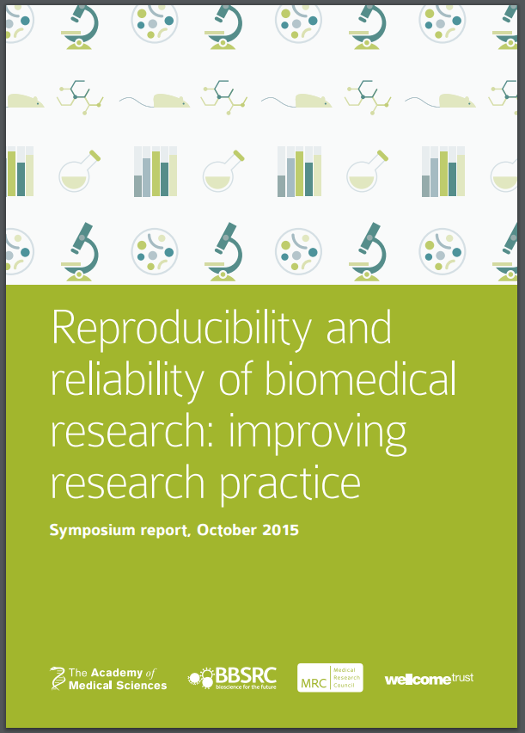
Causes of replication failure
Underpowered studies
False negatives
Temptation to ‘fudge’ results
Biased analysis, poor design, poor analysis :
False positives
Questions can’t be answered
Questionable research practices
False positives, suppression of negative findings
Much of our work has suffered from this.
Things are improving….slowly
https://acmedsci.ac.uk/policy/policy-projects/reproducibility-and-reliability-of-biomedical-research

Slide 14
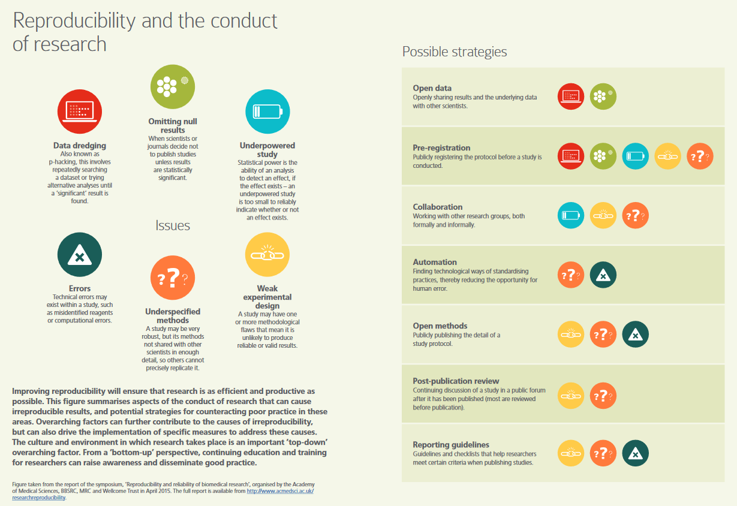
https://acmedsci.ac.uk/policy/policy-projects/reproducibility-and-reliability-of-biomedical-research

Slide 15
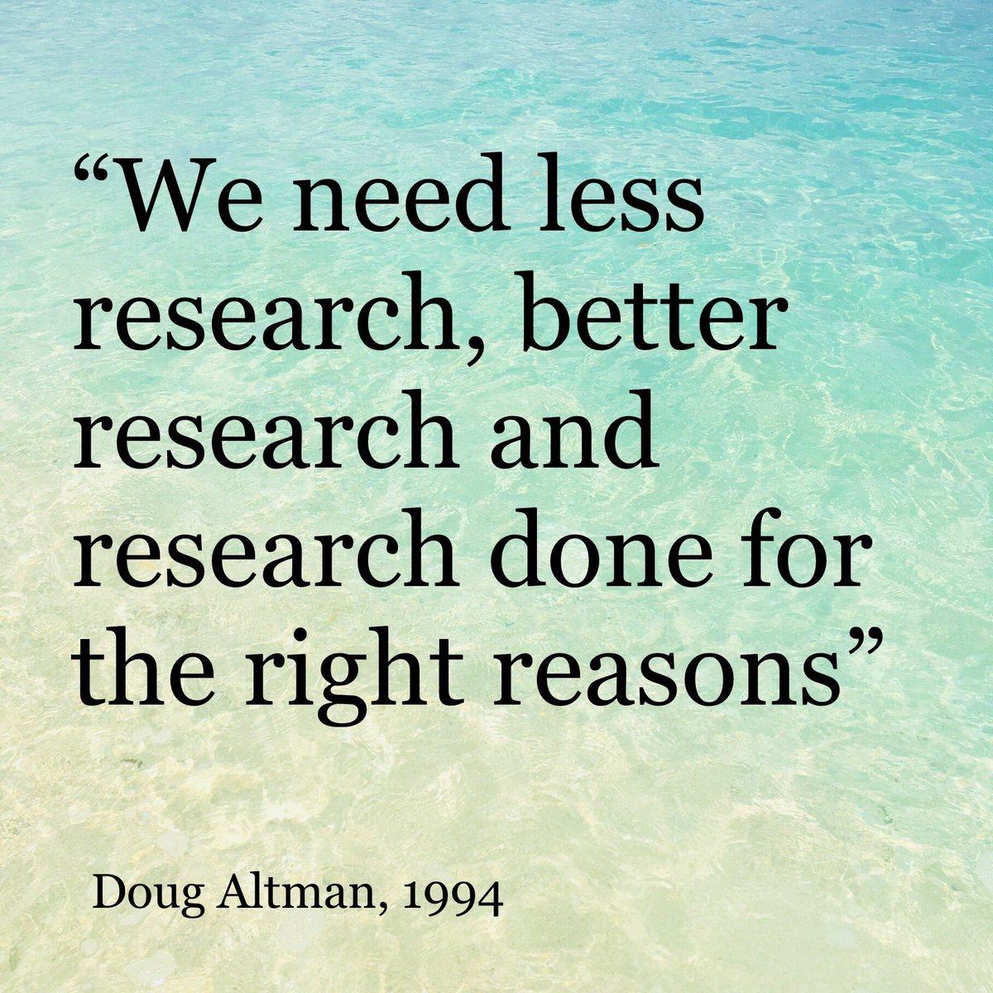
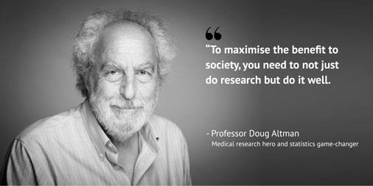
Can we do better?
Medical research, led by clinical trials of pharmaceuticals, had a renaissance in the late 1990s.
This is beginning to happen now in other fields including ours
Better study design
Better study analysis
Better reporting
Doug Altman (1948-2018)

Slide 16
Why experimental design?

Slide 17
Why do we do what we do?
Why are we doing science?
What is our job as scientists or students?
How do we achieve this?

Slide 18
Experiments and observational studies
What is the goal of a research study?
Learn something?
What would success or failure look like?
Success – generate useful and correct knowledge
Failure – learn nothing, be mislead, cause some other problem!

Slide 19


Our simple motivating example
Cage A (usual diet)
A simple experiment:
We want to know whether our candidate dietary supplement is good for gut health
Design plan
Two litters of mice, one treated and one control.
First litter – placed in cage A, treated with usual diet
Second litter – placed in cage B, treated with supplement
Cage B (plus supplement)

Slide 20
Our simple motivating example
Cage A (usual diet)
Analysis plan
Collect fecal samples from each cage/mouse?
16S sequencing on the results
Measure the microbial richness (number of species) in each mouse
Check if dietary intervention group has a higher richness
If so, conclude our supplement is beneficial for gut health
Cage B (plus supplement)

Slide 21
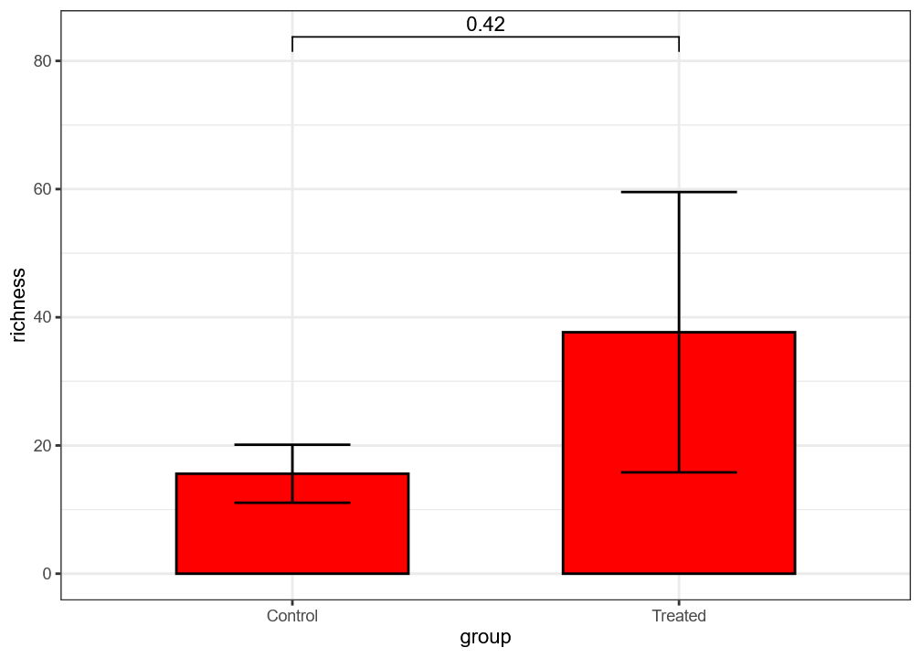
Results
P-value between groups = 0.42
What would your conclusion be?
What aspects of the design, analysis or reporting might concern you?

Slide 22
Experimental design considerations
Research question
Precise enough question?
Useful enough question?
Experimental Design
Measures – useful, meaningful?
Allocation to treatments
Risk of bias – confounding
cage / time / litter / sequencing batch
Low precision/power - sample size
Reporting
Data points
Statistical tests
No details of mice
Other measures considered?
Missingness?
Interpretation
Other?
Quality control
Fidelity

Slide 23
What is our goal
We want to avoid
Harmful findings
Waste
False positives
False negatives
Bias (size of effect errors)
Direction of effect errors
Imprecision / inefficiency
Sloppy mistakes
Learning things that:
We already know
Nobody cares about
We want findings that are
Valid (true)
Unbiased
Precise
Useful
Generalisable
Replicable
Novel
Robust
Ethical

Slide 24
Fundamental experimental design/analysis equation:
Outcome = Effect of interest + Biological effect + Technical effect + Random Error
What we care about
Observable factors related to the experimental units
Factors related to our experimental design
Measurement error
Variation between units
Unmeasurable factors
Treatment error
What we can measure (readout)
Effect of A vs B
Estimate?
Test?
Interactions?
Individual
Species
Genotype
(Sex)
Lab conditions
Treatment variation
Contamination
Time of year
Assessor
Alpha diversity
Health
Measurement error
Between-plant variance
From Lazic (2016)

Slide 25
So how should we design our experiment?
What should we have done to estimate the effect of treatment?
How do we make decisions about material, layout, measurement etc...

Slide 26
Elements of experimental design
What do we ultimately want to know?
Eg: Is treatment beneficial for gut health?
Analysis
How will you use data answer the question set out in the objectives?
What comparisons will you make?
What quantities will you estimate
Design
Interventions
Replication
Sampling
Allocation
Sample size
Material
Sampling frame
Samples
Controls
Exclusion criteria
Research question(s) (Question you will actually answer)
Do mice fed with supplement for four weeks have a more diverse microbiome than mice fed with usual diet?
Measurement
What to measure?
When to measure?
How to measure?

Slide 27
Setting the question
Every experiment needs a clear question to be designed well
It needs to be a question that has an answer, and it will be clear when the question has been answered
Real NBI example:
“We want to investigate the bacteria found on different retail meat products, how many samples should we take?”
First, this is not a question
Second, you can’t say when the aims have been met
So how can you design this? Needs to be much more specific, even though its an exploratory study
Our simple study aims to test a hypothesis of a causal effect.
Dietary supplement -> Gut health
Not every experiment is to test a causal effect.
What other kinds of questions are there? (apart from causal)
Exploratory
Descriptive
Measurement/validation
Predictive
Others?

Slide 28
Inductive vs deductive research?
Inductive research:
Discovery – exploratory
Hypothesis generating
Not enough prior knowledge about a system to form a model or hypothesis
Goal - exploring the model space
Deductive research:
Setting a precise question and confirming a hypothesis
More available prior work
More directly actionable findings?
Different design and analysis methods will be needed
Not always clear distinctions
Many microbiome studies have inductive aims and methods but deductive interpretation
Paradigm
Broad aim: explore a system
Conclusions: Claims of associations, Require experimental confirmation?

Slide 29
Are these different questions?
How do the gut microbiomes of people with rheumatoid arthritis differ from healthy controls?
Can the gut microbiome be used to diagnose RA?
Does the gut microbiome contribute to the development of RA?
Can the gut microbiome predict RA?
Is the gut microbiome a risk factor for RA?
Are they solving different problems?
Is there a different purpose?
Do these need different study designs? Different sample sizes?
Different approaches to analytic issues?
Who is going to benefit from this knowledge, and how will it be used?
Does showing an association between microbiome and RA answer any question?

Slide 30
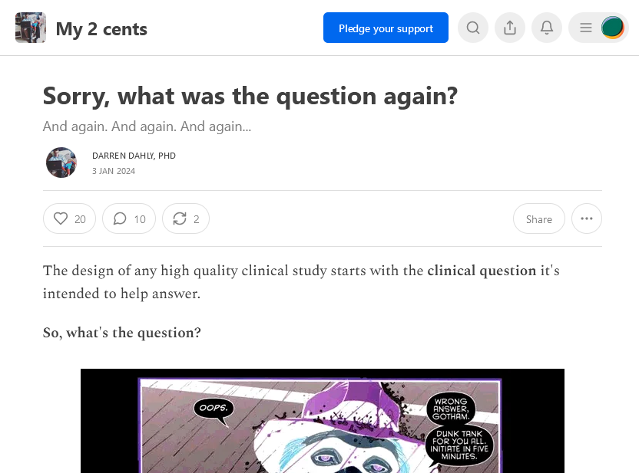
Avoid muddy thinking about questions
Questions can be
Descriptive, causal, predictive, or methodological
Does dietary supplement improve gut health?
In whom (which population)
With what background
In which conditions?
Explanatory (can it in the lab ?) / Pragmatic (does it in practice?)
By what measure?
Superior / non-inferior / by how much?
Over what time period?
Exactly what treatment? – Dose
Compared to what?
https://statsepi.substack.com/p/sorry-what-was-the-question-again

Slide 31
Estimation vs Testing for causal questions
What is the most useful question to answer?
Does supplement A improve gut health?
By how much does supplement A improve gut health?
Hypothesis Testing
Estimation
Useful to whom?
https://www.nature.com/articles/d41586-019-00857-9 Amrhein et al (2019)

Slide 32
How might we answer the question
Putting aside the question of design for the moment…
How might we answer the question of whether A is the better medium.
Or by how much?
Plant growth results
Control
12
5
32
17
12
Treated
7
80
26

Slide 33
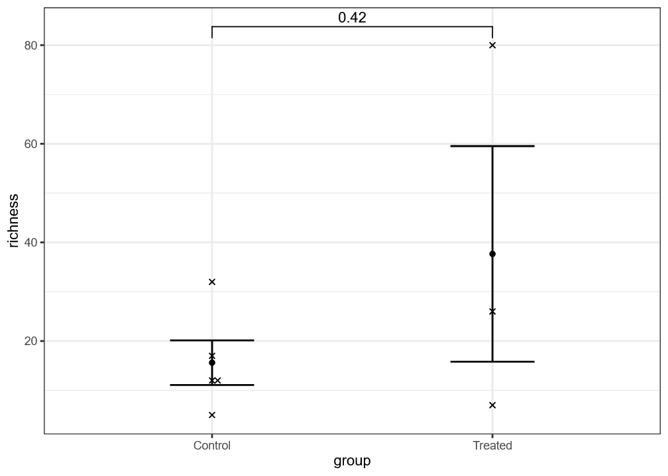
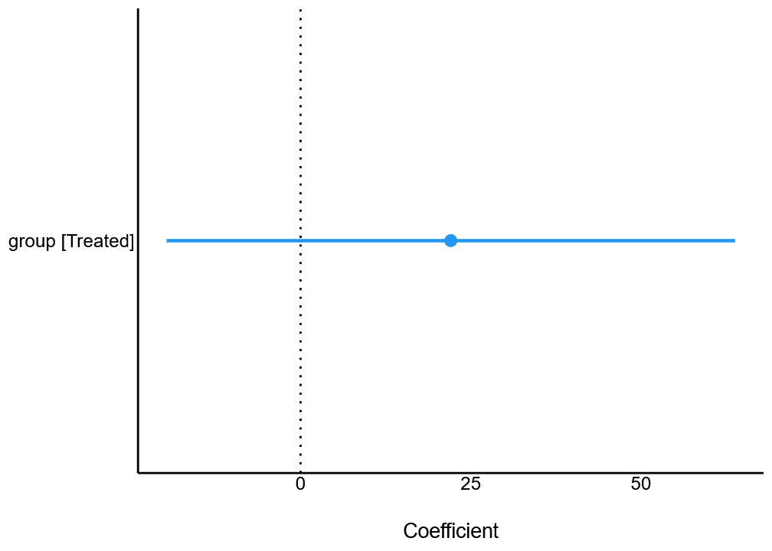
Estimation vs Testing (for causal questions)
Estimated mean difference in richness (lm): 22 , 95% CI = (-19.4 to 64cm), p=0.24
Estimated mean difference in richness (t-test): 22 , 95% CI = (-67 to 111), p=0.42
Show individual points, but still just a p-value
Can you interpret each analysis?

Slide 34
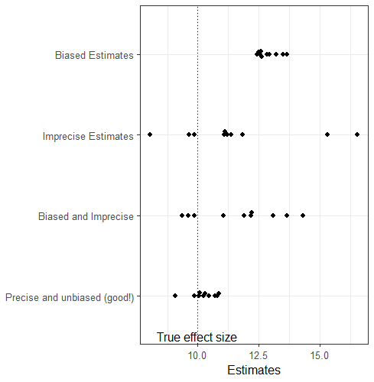
Estimation – bias and variance
If we can think about the answer to our research question as one or more quantities to be estimated,
then we have a good framework for experimental design:
Estimate the answer to our research question with little bias and high precision.
So how do bias and imprecision arise…..?

Slide 35
Fundamental experimental design/analysis equation:
Outcome = Effect of interest + Biological effect + Technical effect + Random Error
What we care about
Observable factors related to the experimental units
Factors related to our experimental design
Measurement error
Variation between units
Unmeasurable factors
Treatment error
What we can measure (readout)
Experimental conditions
Treatment variation
Batch of medium
Contamination
Time of year
Assessor
Effect of our treatment or exposure
Individual
Species
Genotype
(Sex)
Measurement error
Between-unit variance

Slide 36
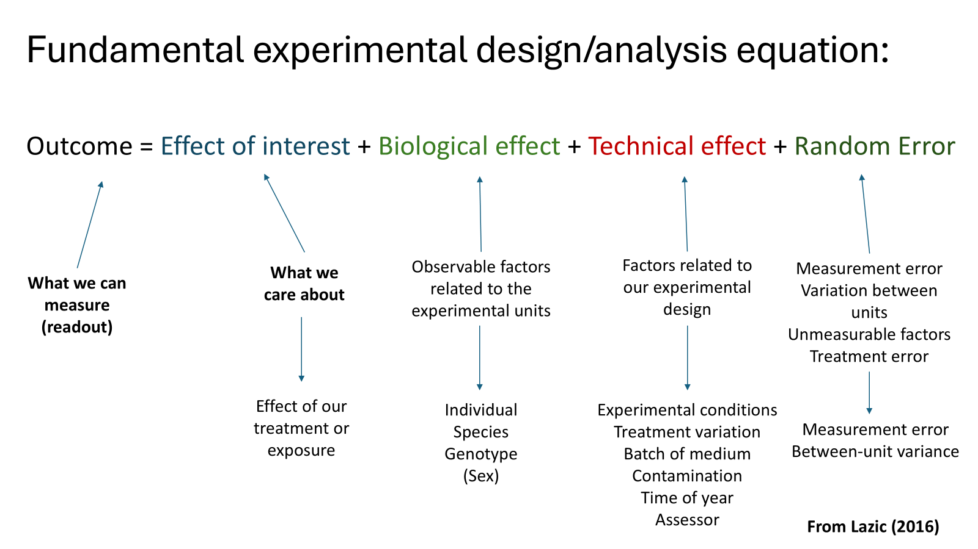
Aim of experimental design
So now we have a framework for experimental design and analysis.
Try to estimate our effect of interest as well as possible
Reduce the bias and noise come from other factors that affect the outcome measure.
The analysis aims to make statements about the treatment effect.
Aim of experimental design:
Account for biological effects, technical effects, and error.

Slide 37
Exercise – Setting a question for an experiment you are planning
What kind of a question are you addressing?
descriptive / predictive / causal / methodological ?
Can you reframe the research question being addressed in precise terms?
Consider: Population, Intervention, Comparator, Outcome, Time period
Can you critique the question?
Consider: Feasible, Interesting, Novel, Ethical, Relevant

Slide 38
Reducing bias

Slide 39
Risk of bias / Avoiding bias
How can we avoid these biases?
Bias Will our expected (average) estimate be different to the truth?
Selection bias – Were the animals equal at baseline?
Performance bias – Were different groups treated equally?
Detection bias – Were different group assessed equally?
Attrition bias – Did different numbers get included in the final analysis? (eg how do we include animals who died?)
Reporting bias – Did we cherry-pick our outcomes to report?
Randomised allocation, Blinding,
Allocation concealment,
Randomised assessment,
Appropriate Controls
Recording and statistical methods, imputation?
Pre-registration of outcomes
Report negatives
Multiplicity adjustments

Slide 40


Research Integrity or How to be a Good Scientist Jo Montgomery, Sarah Inglesfield, Anne Segonds-Pichon, Laura Biggins, Stacey Wagstaff and Simon Andrews v2025-10
This course material is © 2025, Jo Montgomery, Sarah Inglesfield, Anne Segonds-Pichon, Laura Biggins, Stacey Wagstaff and Simon Andrews. This course material is distributed under the creative commons Attribution-Non-Commercial-Share Alike 2.0 licence. Full details of this licence can be found at http://creativecommons.org/licenses/by-nc-sa/2.0/uk/legalcode
Notes:
Introductions of trainers
Intro training
This is a training course but it is very much discursive, critical thinking around research integrity - there are black and white things on what are the right or wrong thing to do but what we are going to focus on is rather the grey areas.
Where there might be threats to acting with integrity and those unintentional spaces.
A discussion of those bits where things might be tested – with reference and relevance to those working in biosciences research.
The notes on these powerpoint slides for this training are a mix of a suggested script or pointers, things to do and be aware of.

Slide 41
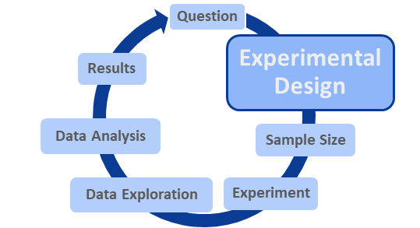
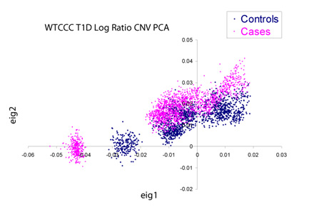
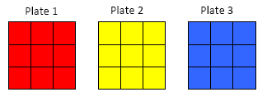

Appropriate Type of Design
Distinguish real differences from experimental artefacts…
…But experiments can be big and complicated
Accountability
Accurate
Care
Collegiality
Cooperation
Ethics
Fair
Honesty
Objectivity
Openness
Quality
Reliability
Reproducibility
Respect
Responsibility
Rigor
Transparency
Seminal Wellcome Trust GWAS Study:
14000 cases of 7 diseases & 3000 shared controls
Each processed at different sites and genotyped on distinct series of plates
Condition 1
Condition 2
Condition 3 etc…
A
Good Design
B
Bad Design
Plate 1
Plate 2
Plate 3
Differences between control and cases are confounded by plate
Notes:
The next thing that we need to think about is sort of the actual design of our experiment and in terms of thinking about what's appropriate here, we need to think what the goal of our experiment design is,
And essentially what we need from our design is that it distinguishes real differences from background noise and that is what makes our design appropriate.
But our experiments are challenging nowadays because they just keep getting bigger and more complicated, and that makes designing an appropriate experiment harder.
So to illustrate this, we'll have a little look at an example: This one comes from the Wellcome Trust – a Genome Wide Association study and what they had, was they were looking at a range of diseases. We have 7 diseases 14,000 cases of these diseases and 3000 shared controls.
What they did with their experimental design - processed these different cases at different sites and they were genotyped on a distinct series of plates.
So in essence they got an experimental design which looks a bit like this, where one condition is on one plate, another condition is on another plate and so on.
First question, your first opportunity to use your voting panels for something less important than biscuits, but what do you think of this design? Do you think it is a good design or do you think it is a bad design? Do you think there might be problems there? So let's see what we think A or B and if you're really not sure - twiddling them the air.
*Tailor feedback depending on the votes*
Yes, I'm seeing quite a lot of B’s out there and then a bit of uncertainty So the issue here which potentially I think a couple of you might have spotted, is that we have a confounding factor in the plates in this design and that's something we can see when we overlay the data with this PCA plot.
A PCA plot spreads out the variance in your data and what you can see here is that our cases and our controls should sit on top of one another, but they don't, and the reason that they don't is because of differences in the plates, which is not a factor we're interested in, it's just noise. So that was the problem with this design.
***These examples are intended to be accessible to anyone with a biosciences background, there’s nothing niche or field-specific, but feel free to change out examples to better fit your audience if required***

Slide 42
Plate layouts
Three disease groups
20 patients per group
Two replicate samples per patient.
For measurement, samples were arranged as opposite on two 96 well plates.
Potential problems here?
Potential solutions?
Other considerations?

Slide 43
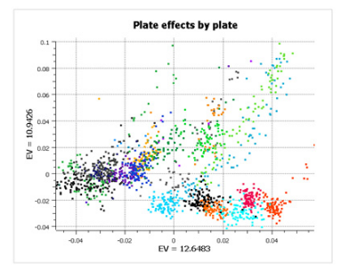
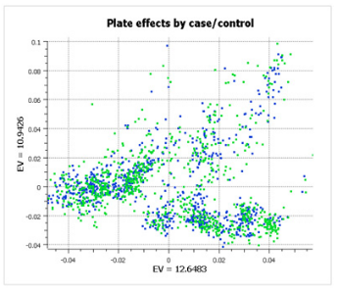
Appropriate Type of Design
GenADA multi-site collaborative study:
Plate 1
Plate 2 etc…
875 Alzheimers patients, 850 controls, 9 sites
Randomised Block Design
Accountability
Accurate
Care
Collegiality
Cooperation
Ethics
Fair
Honesty
Objectivity
Openness
Quality
Reliability
Reproducibility
Respect
Responsibility
Rigor
Transparency
Accountability
Accurate
Care
Collegiality
Cooperation
Ethics
Fair
Honesty
Objectivity
Openness
Quality
Reliability
Reproducibility
Respect
Responsibility
Rigor
Transparency
Still have differences between plates
Doesn’t confound the experiment
https://blog.goldenhelix.com/stop-ignoring-experimental-design-or-my-head-will-explode/
Notes:
But we can address this kind of issue with our design.
This is another example of a very large genome wide association study. And again it's across multiple sites. It's got multiple conditions and controls.
But what they did here was something called a randomised block design. Where basically you get equal representation of the conditions across the different plates and when you look at the results of this data, our PCA plot still shows that the plating does cause separations.
The different colours are different plates.
But if you colour it instead by the cases and controls, they now sit on top of each other
And so what this shows us is that the of variance here doesn't result in this nuisance variance between our conditions of interest.
So the point is here is that we need to make sure that we're considering our experimental design very carefully to avoid these compounding issues, which could then impact on our experiments.
We can't always avoid these factors, but we can plan for them.
***These examples are intended to be accessible to anyone with a biosciences background, there’s nothing niche or field-specific, but feel free to change out examples to better fit your audience if required***

Slide 44
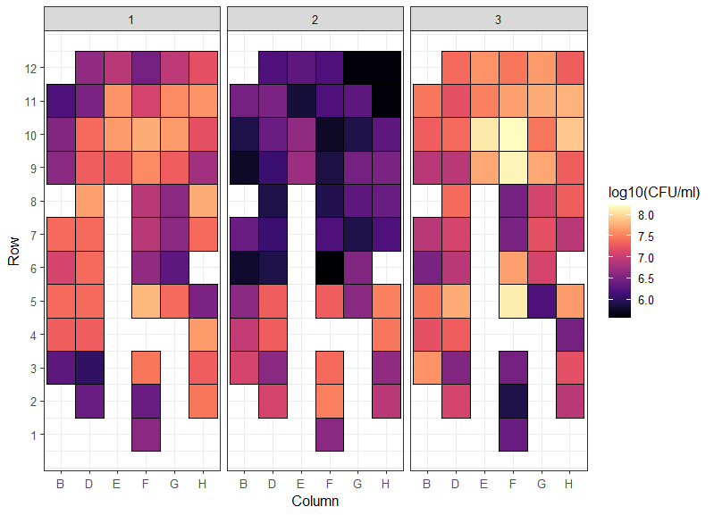
What can we see here
Three plates of cells.
Colour corresponds to CFU/ml of pathogen growth in each well
Here - each well was treated identically
How will this affect the outcome of an experiment using these plates?
How should we apply treatments to test their effect on cell growth?
What are the risks? How can we avoid this?

Slide 45
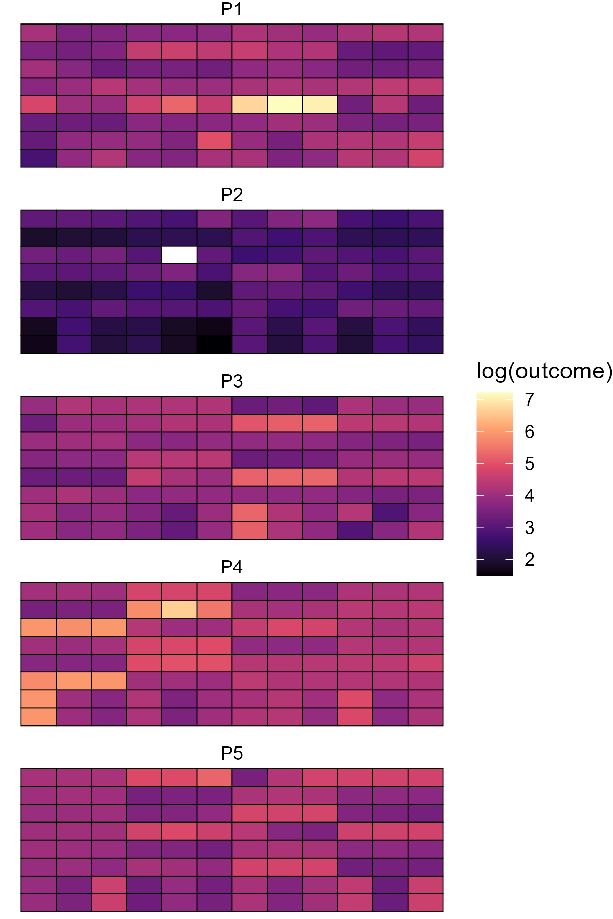
Results per plate
Levels of a metabolite following fermentation.
What can you see here?
What potential issues could there be in design, analysis or interpretation if comparing treatments.
How could we avoid this?

Slide 46
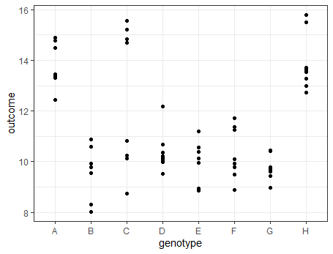
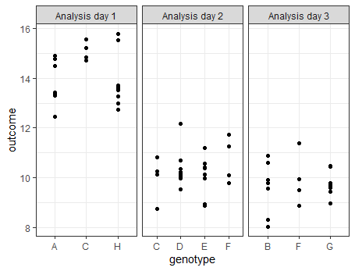
Real(ish) Example
A group analysed the properties of eight genotypes of wheat.
What can we conclude?
Did something happen between days 1 and 2?

Slide 47

Real NBI example 1: Brains and Bias
Scenario
A student was measuring the effect of a genetic mutation on brain lesion frequency in mice
Lesions are counted by hand using image analysis software
First she counted the lesions from brains of in the wild-type mice, next she counted the lesions from brains of the mutant mice
What sources of bias might there be? What should she have done to reduce this?

Slide 48
Brains and bias
Technical factors that might affect the measurement and bias the results?
Order effect
Cognitive bias
Anything else?
Deal with by
Randomisation! (Simple / Blocked)
Blinding
Reduce random error by automation (if possible) or repeated measurement?
Design equation (just for the counting phase..):
lesions = genotype effect + order effect + cognitive bias + mouse effect + measurement error
outcome
‘treatment’ effect
technical factors
random error

Slide 49
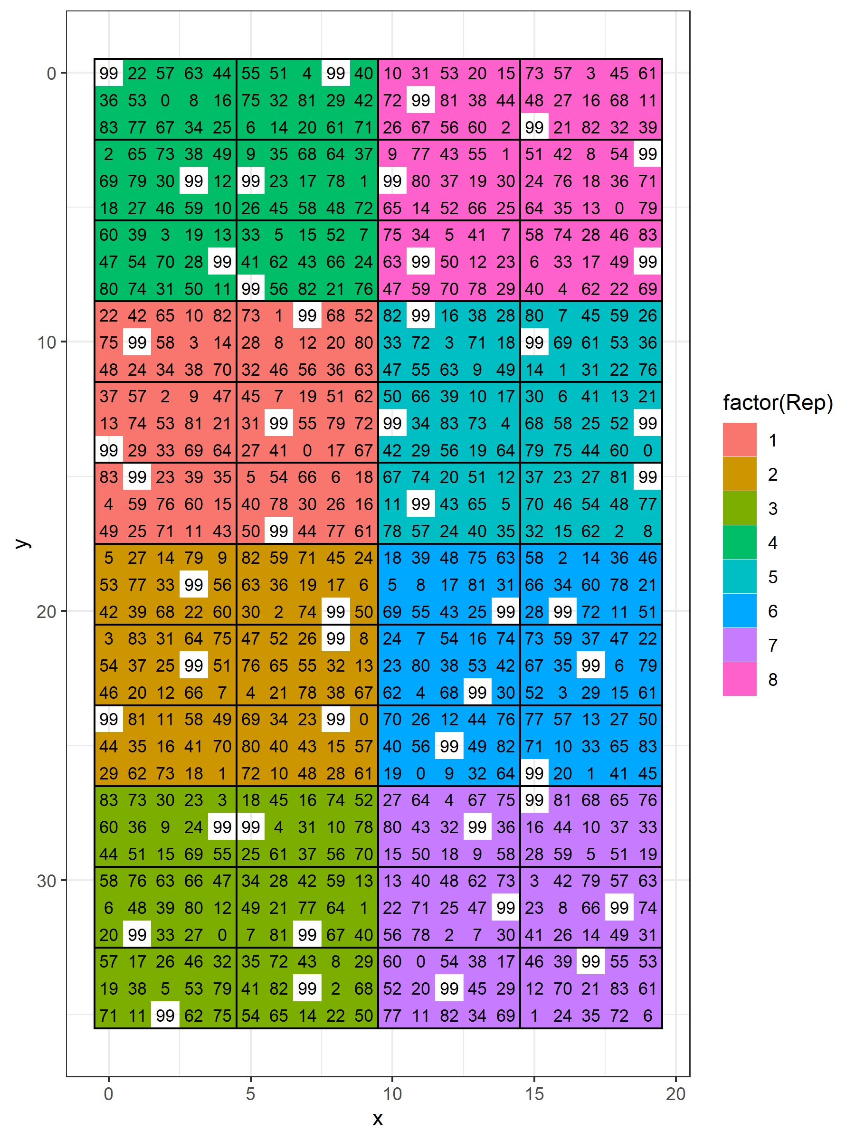
Clinical trials, field trials vs animal and lab studies
We are very used to the idea of randomly allocating participants to treatments
Or randomly allocating treatment order within participants
Field studies also use complex randomisations
We understand why this is necessary?
But we don’t apply the same standards to lab work, order of assays, animal studies, etc?
An alpha lattice design in the field

Slide 50
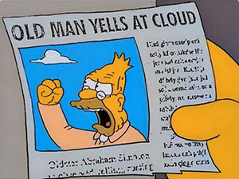
Nothing (much) in here is new
“…. these lessons appear to be either unread, ignored, not believed, or forgotten as each new wave of researchers is introduced to the brave new technical lexicon of medical research….”
Goodman (2008) A Dirty Dozen: Twelve P-Value Misconceptions, Seminars in Hematology 45 (3) https://www.sciencedirect.com/science/article/abs/pii/S0037196308000620

Slide 51
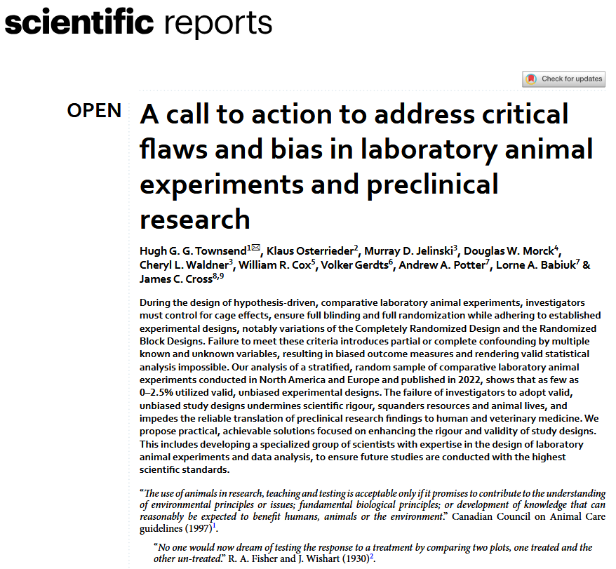
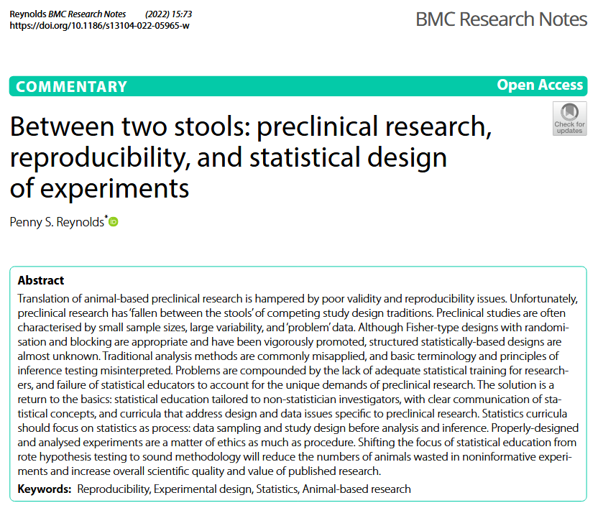
2022
2025
https://pubmed.ncbi.nlm.nih.gov/35189946/
https://www.nature.com/articles/s41598-025-15935-4

Slide 52
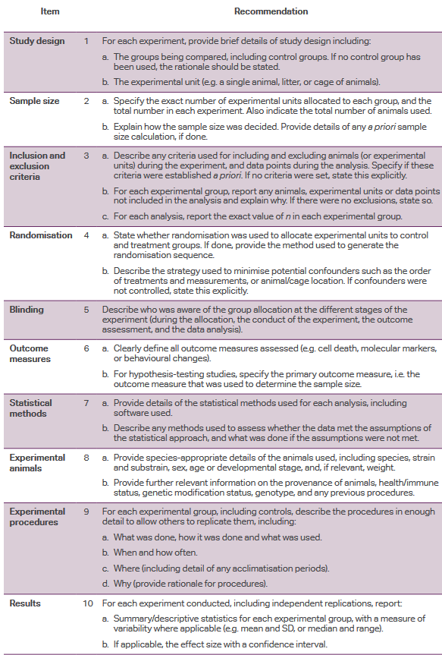
Design and reporting checklists
CONSORT statement and checklist for clinical trials ensures that the key elements of design are reported.
ARRIVE guidance now exists for animal work..
Reporting guides for many different types of studies exist
Review these in your design phase, make sure you have every element covered.
Often when reading biology papers it is very hard to work out what the experimental design was!
ARRIVE essential ten
https://arriveguidelines.org/

Slide 53
Nuisance factors

Slide 54
“Nuisance factors”
Outcome = Effect + Biological factors + Technical factors + Random Error
Cell growth = Treatment + Plate + Plate position + ? + Clustered random error
Nuisance factors include anything that might affect an outcome measure
Known or unknown
Controllable or uncontrollable
Measurable / observable or not
Scientifically of interest or not
Related to the exposure or not
Random or fixed
Nuisance factors:
Add bias (high risk of false positives)
Add noise (loss of power and precision)

Slide 55
Directed acyclic graphs can help
Outcome = Treatment + Biological factors + Technical factors + Random Error
We assume: Group mean difference = Treatment effect + Error
Adds systematic error / bias
Adds noise / lose precision
When do the nuisance factors matter?
Z
Z can also affect outcome!
e
How do they affect the relationship between group differences and true effects?
Treatment associated with Z
Random error
Treatment
Outcome
Effect of treatment on outcome

Slide 56
How can bias be avoided?
Adds bias
Adds noise
Adds noise
Z (eg batch)
To remove bias, we must:
Break the link between Z and Treatment
or
Break the link between Z and Outcome
or
Prevent Z from varying at all
Randomisation ensures that on average, Z is equal across treatment groups
e
Treatment
Outcome
How to break the Z -> X link?
Balance (blocking)
Randomisation
Other methods (eg) blinding/masking
Break the Z -> Y link
Statistical correction

Slide 57
Dealing with effects of nuisance factors
What technical factors might affect the outcome measure?
How do we deal with them?
What might happen if we just ignore the technical factor
How do we deal with technical/biological factors we don’t know about or can’t measure?
Experimental layout
Eg – suppose we suspect that temperature is important an outcome measure
A | A | A | A | B | B | B | B
A | A | A | A | B | B | B | B
Suspected temperature gradient

Slide 58
Dealing with technical and biological factors
Homogeneity
hold temperature constant (may be impractical, lose generalisability. Could work for species or sex)
Matching / Blocking
ensure you have comparisons between treatments among units grown at equal temperature
Statistical control
record and control for temperature differences in analysis
Randomisation
assign units randomly to ensure temps equal on average

Slide 59
Different designs
Don’t do this!
Randomisation is essential for validity of experiments
Temperature gradient
Row 1
A | A | A | A | B | B | B | B
A | A | A | A | B | B | B | B
Non-randomised design
Accidentally confounded temperature with treatment
Potential for other unknown factors to interfere
Row 2
Row 1
A | B | A | B | B | A | B | B
A | A | A | A | B | B | B | A
Simple randomisation
Row 2
Valid and unbiased but potentially inefficient
Row 1
A | B | A | B | A | B | A | B
A | B | A | B | A | B | A | B
Simple blocking
Blocking is a often a good idea
Row 2
Row 1
A | B | B | A | B | B | A | B
B | A | B | A | A | A | A | B
Randomised complete block design
Blocking controls for temperature (known factor)
Then randomising within blocks removes bias from unknown factors related to location.
Row 2
Block 1
Block 2
Block3
Block4

Slide 60
Identifying nuisance variables
Suppose we want to test the effect of a treatment on microbial richness in mice?
Treated mice (N=20)
Untreated (control) mice (N=20)
We need to keep mice in groups of four
We need to run sequencing in two plates
How should we approach this?
What nuisance factors might there be?
Nuisance variables
(what might affect the measured value of microbial richness?)
Mouse variation
Mouse age, sex, background diet
Housing conditions
Cage effects?
Lab tech?
Measurement factors
Sequencing Batch
Potential bias from each source

Slide 61
Design equation
Richness = Treatment + mouse characteristics + lab conditions + sequencing effects + …. + measurement error
How do we ensure these covariates don’t bias the outcome?
Ensure no links between each of these nuisance factors and treatment
Randomisation
How do we reduce the variation associated with each factor?

Slide 62
Bias/variance reduction methods
1) Try to reduce variation associated with each source of bias?
2) Balance / blocking
Paired samples – each mouse gets both treatments?
Equal numbers treated/untreated across sex etc..
3) Randomisation
Mice randomly allocated to cages?
Cages randomly allocated to treatments?
Random order for sequencing?
4) Statistical correction to remove variance
Adjust for these factors in the analysis model!
Helps avoid imbalance, improve precision
But difficult to do with many factors at one
Removes bias from known and unknown factors
Requires factor to be known and measured
The better the balance, the better the correction

Slide 63
How to analyse
“Analyse as you randomise”
If you had a blocked experiment, you must include the block in your analysis
If you have a clustered randomisation, you must respect the clusters in the analysis

Slide 64
Design model informs the analysis model
A statistical model describes how the outcome depends on measured predictors
A simple two group comparison (1-way ANOVA, t-test etc) is not a suitable analysis method
Here we need an ANCOVA or linear regression model
But the design gives us a very good starting point
Richness = Treatment + mouse characteristics + lab conditions + sequencing effects + …. + measurement error
Richness = Treatment + Random Error
Model implied by 1-way ANOVA / t-test

Slide 65
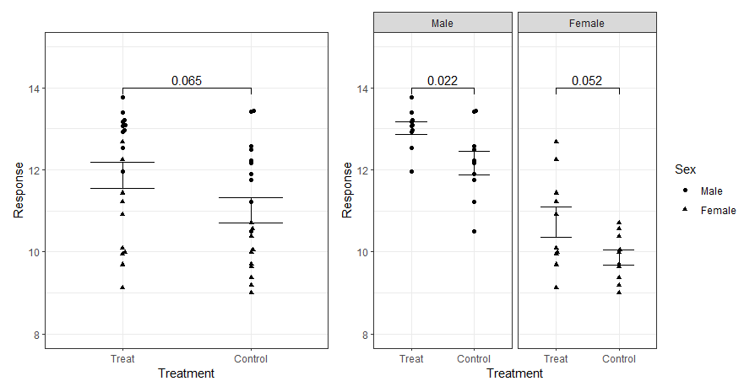
Simple simulated experiment stratified by sex
Probably not relevant
Simulated randomised experiment
True effect = 1 unit
Sex effect is present
N=20 per group
Simple t-test, p=0.065
What happens if we stratify by sex?
y = treatment + sex + random error

Slide 66
Stratified analysis are more efficient
> lm( y ~ treatment )
Estimate Std. Error t value Pr(>|t|)
(Intercept) 11.8667 0.3189 37.21 <2e-16 ***
treatmentControl -0.8568 0.4510 -1.90 0.0651 .
Power=63%
y = treatment + random error
> lm( y ~ treatment + sex )
Estimate Std. Error t value Pr(>|t|)
(Intercept) 13.0143 0.2233 58.278 < 2e-16 ***
treatmentControl -0.8568 0.2579 -3.323 0.00202 **
sexFemale -2.2952 0.2579 -8.901 9.93e-11 ***
Power=88%
y = treatment + sex + random error

Slide 67
Summary
Identify key nuisance variables
Split units into blocks based on these
Randomise within each block
Consider other measures for removing variance
Include blocking factors and other key predictors in data analysis

Slide 68
When do I need to think about randomising
Where might a known or unknown nuisance factor affect my outcome measure?
Treatment allocation to remove biological effects
Time of day / litter / background diet
Participant / donor factors
Plate layouts / greenhouse layouts / treatment order
Order of assessment / reagent supplier
Sequencing batches
Assessors / operators / software / confirmation bias?

Slide 69
‘Change one thing at a time’ is wrong unhelpful
A paradigm for experiments is to change the experimental condition while “holding all other factors constant”
This homogeneity is one approach but..
Often impossible
Not necessary
Reduces generalisability
Limits analyses
Eg: You must now include male and female mice in most animal experiments
Instead:
Blocking
Randomising
Factorial experiments
Statistical Modelling
https://nc3rs.org.uk/3rs-resources/mrc-nc3rs-webinar-using-both-sexes-animal-experiments

Slide 70
Why don’t we randomise already?
Cultural traditions
Don’t even think about it or realise it is necessary
Everyone has always done things this way
Inadequate support / training
Don’t know how to randomise in my setting
Randomising risks introducing more technical errors
Randomisation makes thing more difficult / time consuming
We can’t randomly allocate because units are treated in clusters
There really is no effect of plate/batch/day/order/person/sex/etc
Standards can correct batch effects
Statistical analysis can correct for covariates
Pragmatic concerns
Statistical misconceptions

Slide 71
Genuine challenges of randomisation
Introduce imbalance
Combine with blocking
Contamination between units?
Suggests an experimental design issue?
Use cluster randomisation?
Technical challenges
Identifying the unit of experiment
Randomisation process itself
Maintaining records
Maintaining blinding or concealment
Requirement for storage of samples
Complexity in analysis?
Extra cost/staff

Slide 72
How can we do better?
More or better training / awareness in design of experiments
More/better statistical support
A culture of methodological study
Research design checklists
Time and space to do things properly
More automation to reduce errors
Better data handling to reduce errors
Cultural traditions
Pragmatic concerns
Statistical misconceptions

Slide 73
Checklists

Slide 74
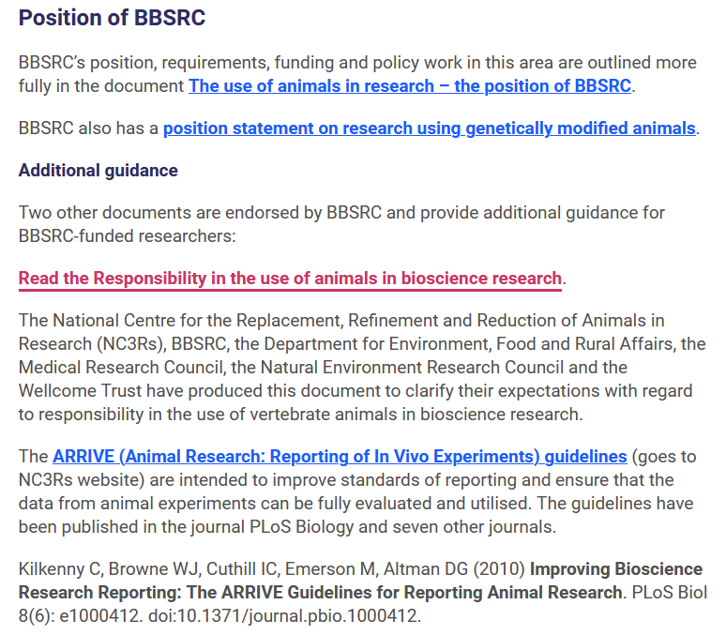

Progress in biology
BBSRC endorses use of the ARRIVE guidelines for animal work
Extremely helpful for high quality and transparent reporting
And to anticipate issues during experimental design

Slide 75
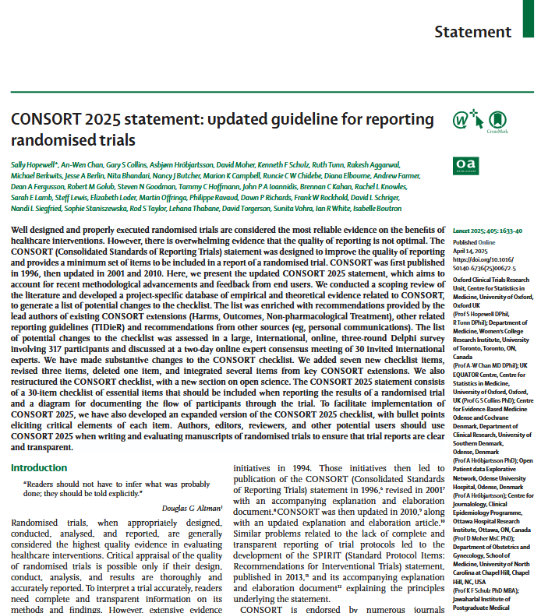
Design and reporting checklists
CONSORT statement and checklist for clinical trials ensures that the key elements of design are reported.
STROBE for epidemiology studies
ARRIVE guidance for animal work
STORMS for microbiome studies
Reporting guides for many different types of studies exist
Review these in your design phase, make sure you have every element covered.
Often when reading biology papers it is very hard to work out what the experimental design was!
ARRIVE essential ten
https://arriveguidelines.org/

Slide 76
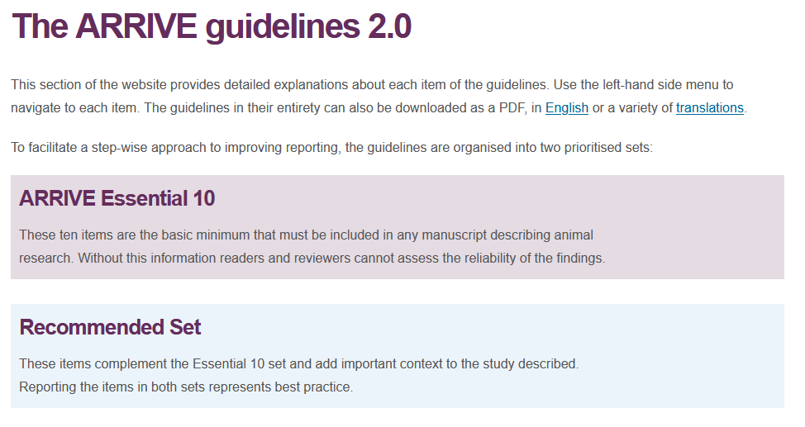

Slide 77
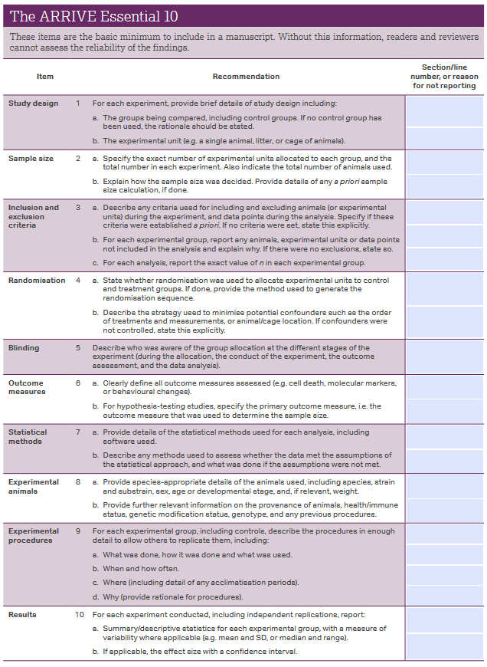
Essential 10

Slide 78
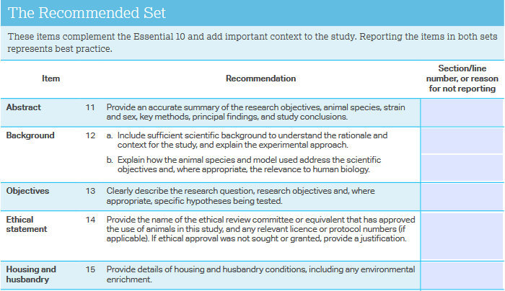
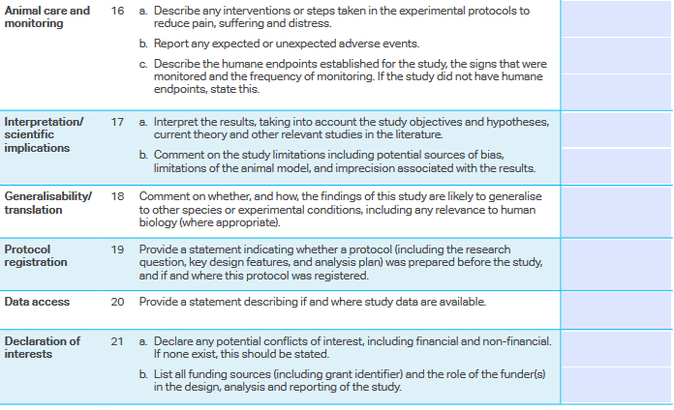
Recommended Set
Should there be and requirement for this?

Slide 79
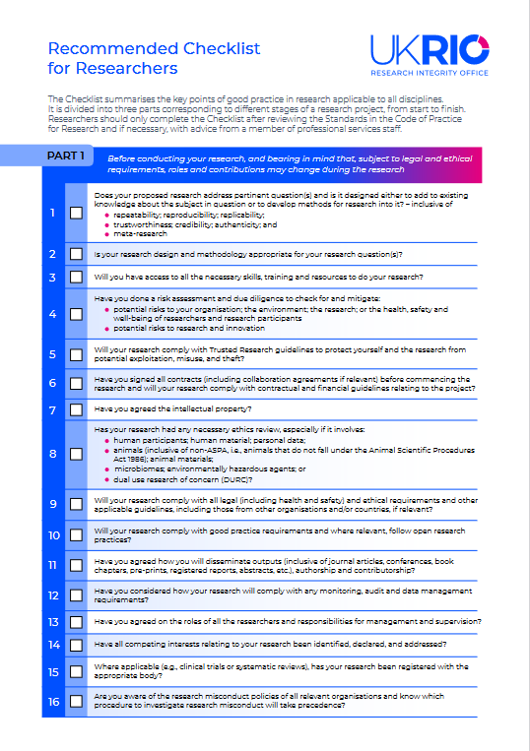
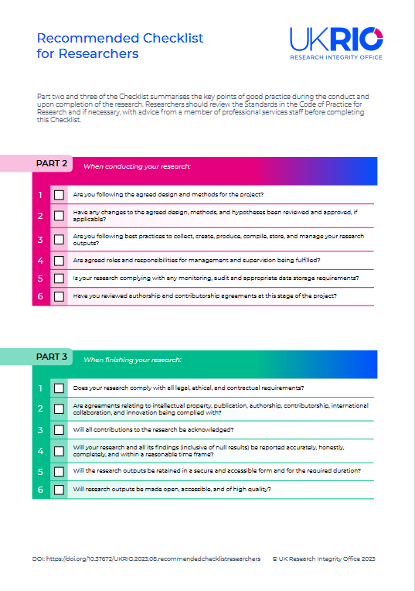
Anticipate potential issues with UKRIO checklist
https://ukrio.org/wp-content/uploads/UKRIO-Recommended-Checklist-for-Researchers.pdf
Planning
Conduct
Dissemination

Slide 80
Summary
Randomisation is the foundation of experimental science
It prevents bias from measured and unmeasured nuisance factors
Blinding, blocking and appropriate statistical analysis are important complements
Randomisation can add time and complexity
But without randomisation, known and hidden nuisance factors can be what is really driving your findings

Slide 81
Cluster randomisation
Suppose mice must be treated in a cluster (eg through cage feeding), with the cluster defined by their litter (cannot randomly allocate units to clusters)
Then we randomise at the cluster level
Unit of experiment is cluster.
Sample size is the number of clusters not the number of mice
Mice are then effectively ‘technical replicates’
Statistical analysis must respect the clustering

